Slide 1
Working Progress
3/9/25 by Md. Yasin Arafat

Slide 2
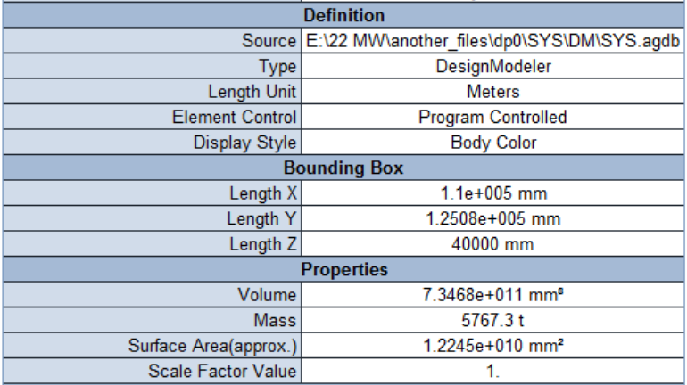
System weight with only hull

Slide 3
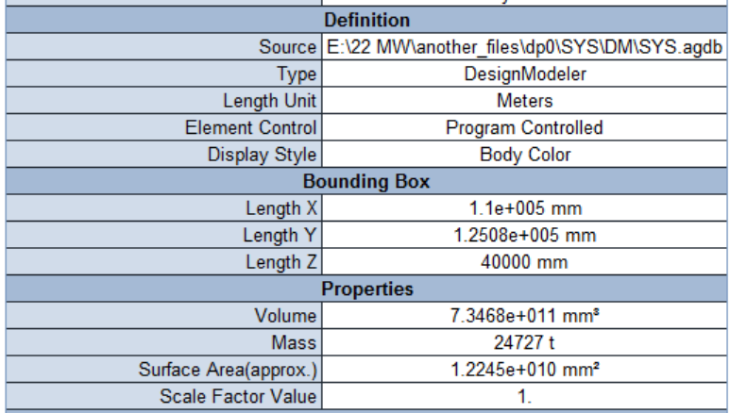
System weight with ballasts as given as point mass

Slide 4
Load and BC
Load was provided as Hydrostatic Pressure and Ballast Pressure
The Boundary Condition was Inertia relief by activating weak springs, commonly used for floating structures.

Slide 5
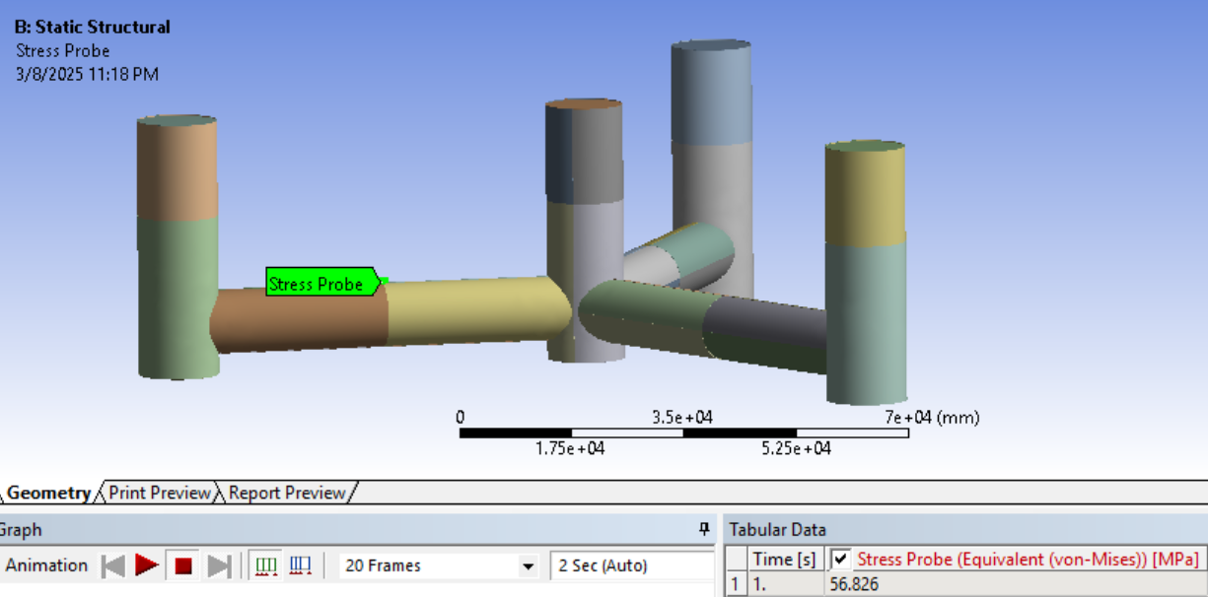
Stress

Slide 6
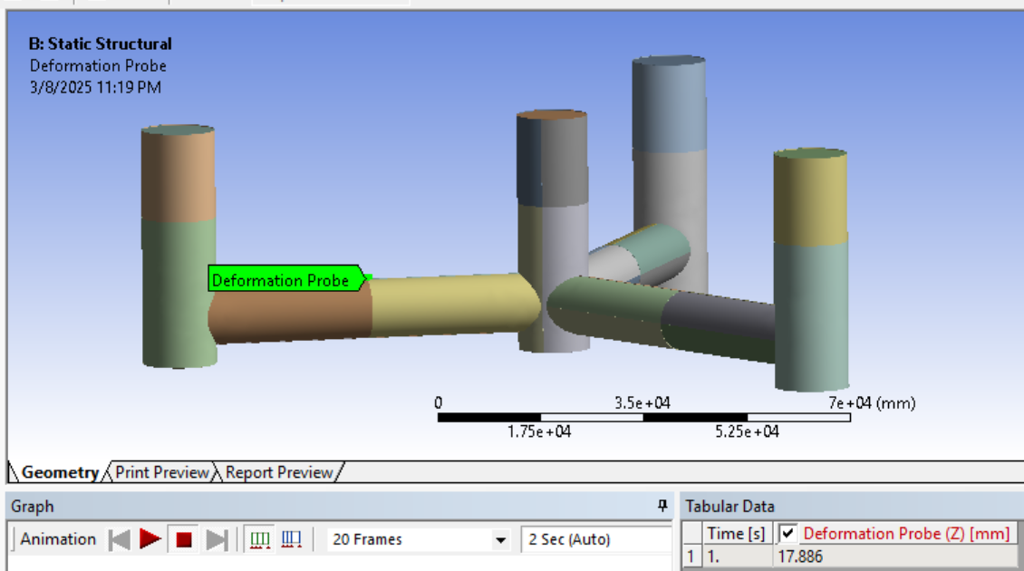
Deformation

Slide 7
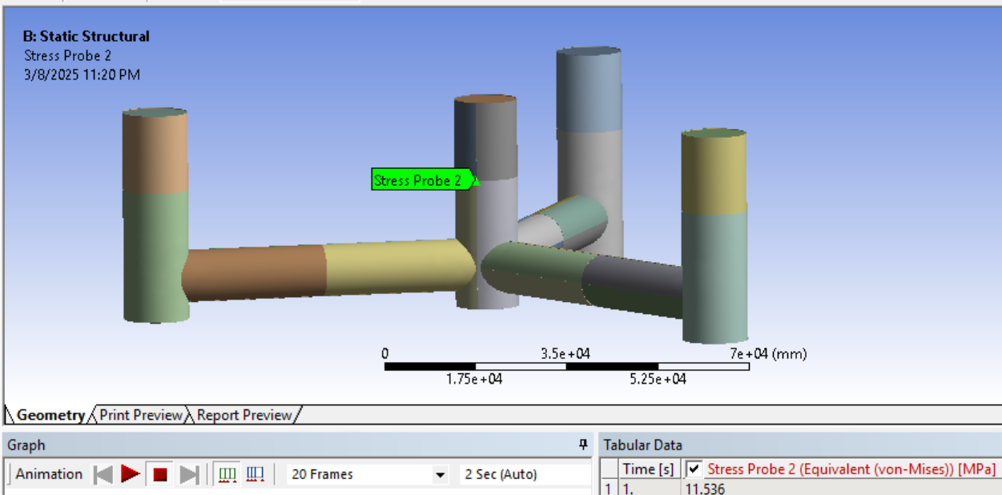
Stress

Slide 8
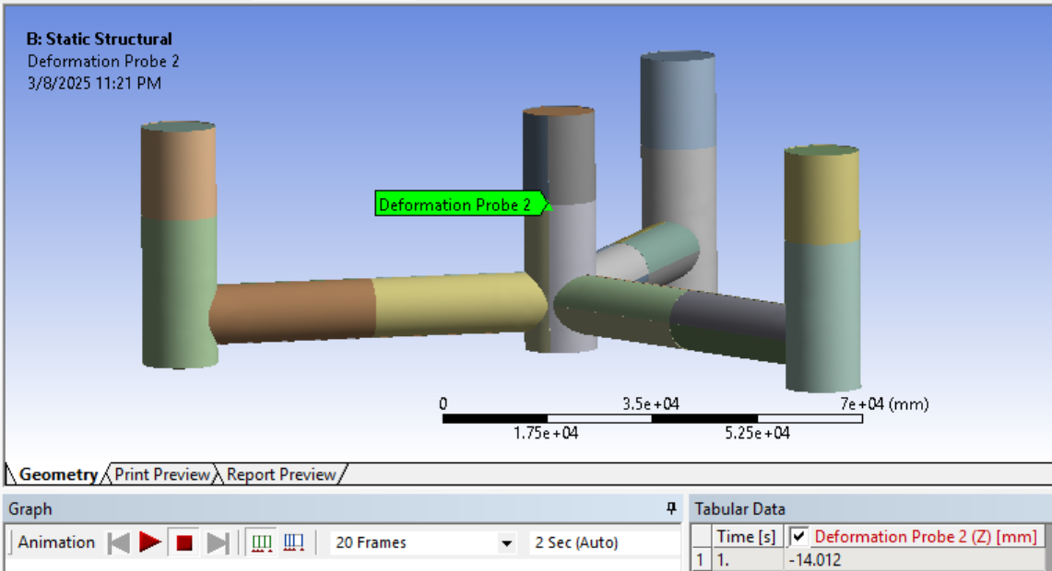
Deformation

Slide 9
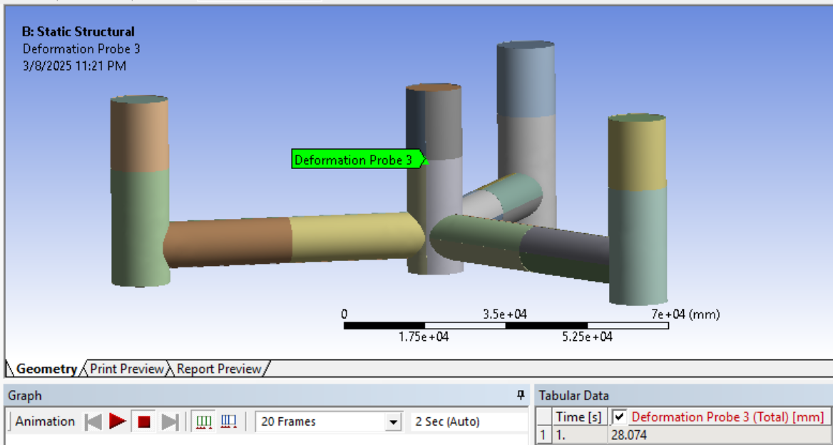
Deformation

Slide 10
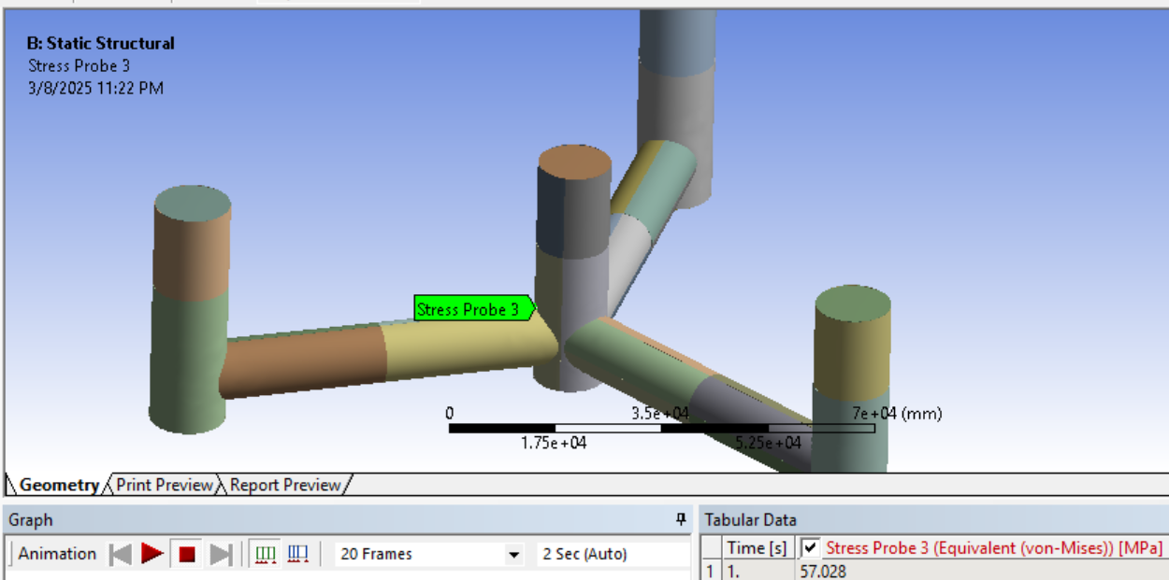
Stress

Slide 11
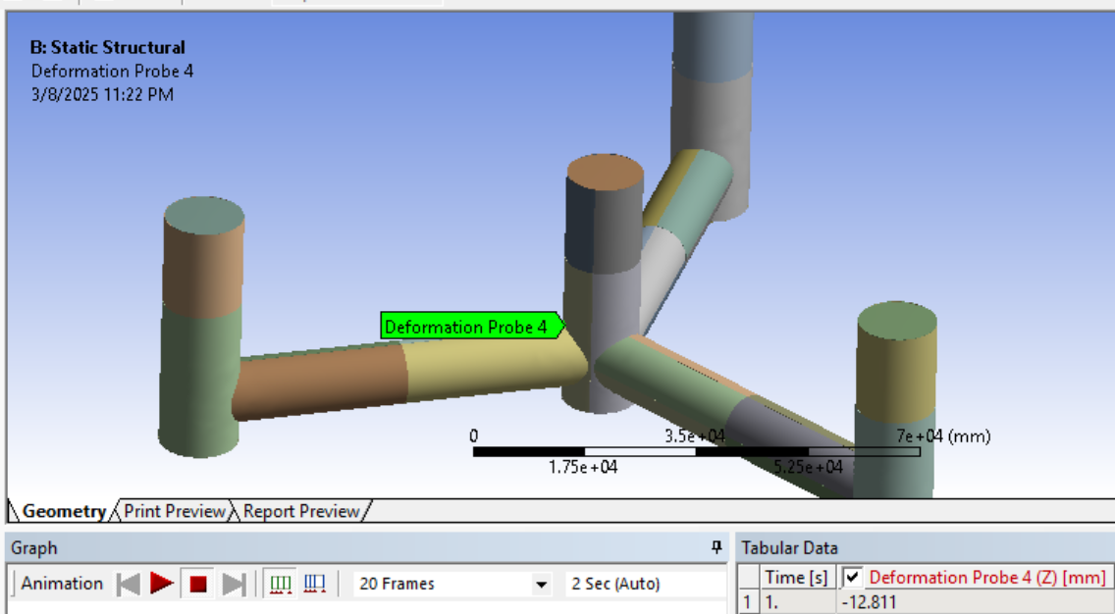
Deformation

Slide 12
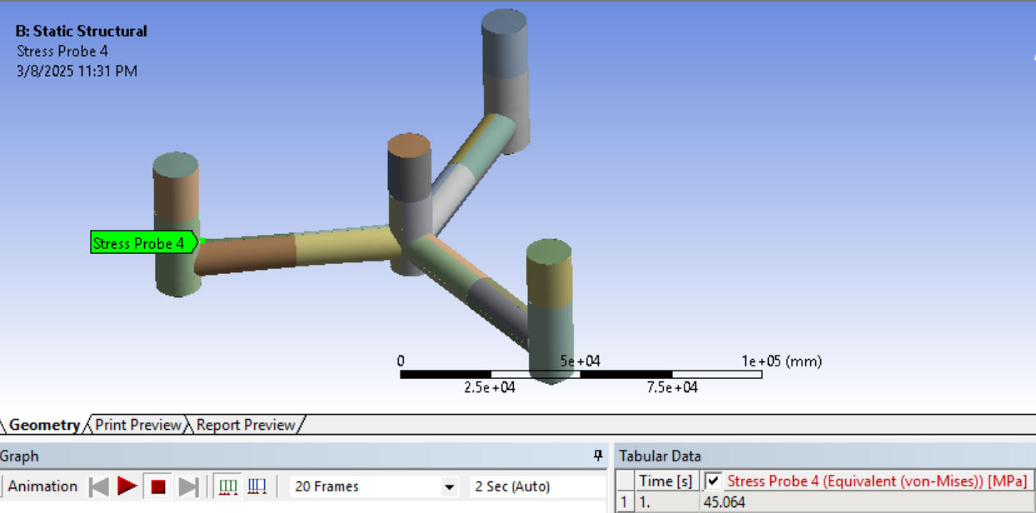
Stress

Slide 13
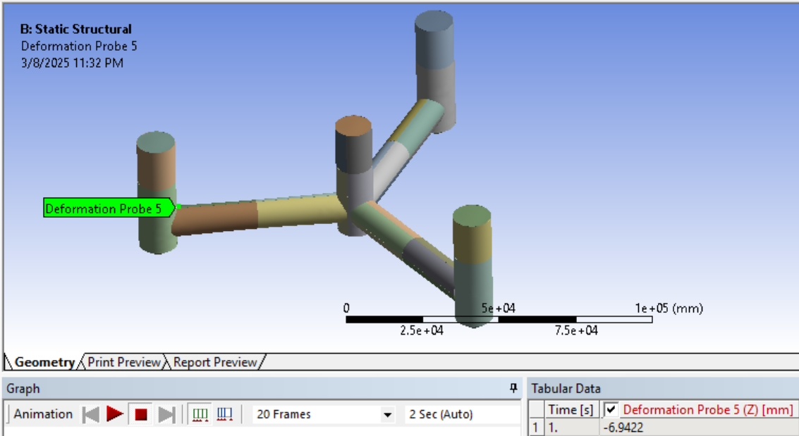
Deformation

Slide 14
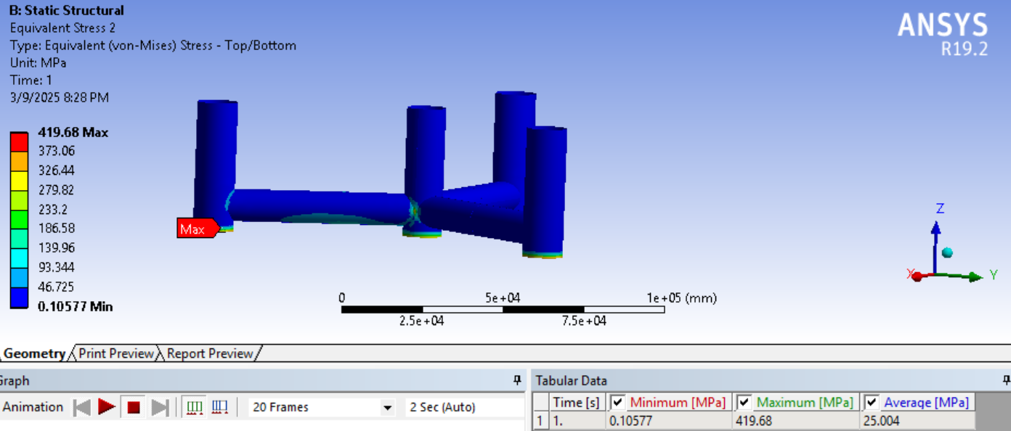
Stress Overall

Slide 15
THANKS FOR YOUR TIME

